Slide 1



BAIL RECKONER
ORGANIZATION: MINISTRY OF LAW & JUSTICE
PS Code: 1702
Problem Statement Title: Bail Reckoner
Domain : Smart Automation
Team Name : The Hogwarts Web Wizards
Institute Name : Vishwakarma Institute Of Technology

Slide 2

PROBLEM STATEMENT
The current bail process is hampered by delays, lack of transparency, and inconsistency in decision-making due to the manual evaluation of various legal parameters, procedural requirements, and judicial pronouncements. This creates challenges for undertrial prisoners, legal aid providers, and judicial authorities, leading to prolonged detention, overcrowding in prisons and potential injustices.
There is a need for a digital solution that can simplify and streamline the bail process, making it easier to navigate and expedite bail applications.

Slide 3

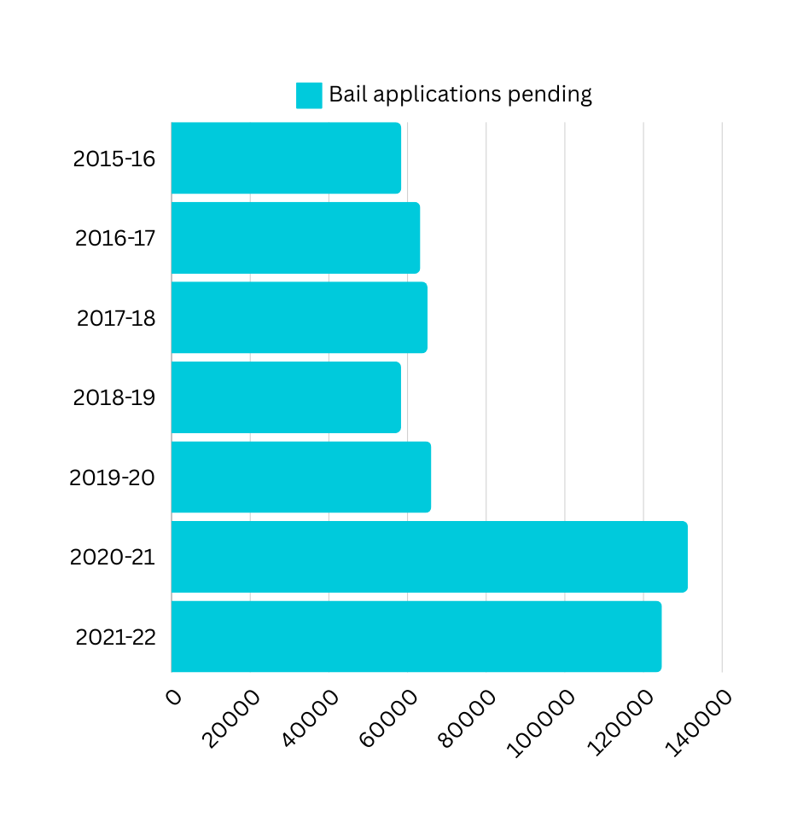
BACKGROUND
The current bail system is deeply flawed, marked by inefficiencies, delays, and inequities. Undertrial prisoners often remain incarcerated for extended periods due to complex and inconsistent procedures, lack of access to legal resources, and the inability to navigate a complicated judicial process. This leads to overcrowded prisons, unnecessary detentions, and significant disruption to individuals' lives. The system fails to uphold the principle of innocent until proven guilty, highlighting an urgent need for a more streamlined, transparent, and fair approach.
Notes:
"Bail is the rule, jail is the exception”.
Innocent until proven guilty
Lack of infra and money
Lack of basic facilities like public sanitation video conferencing

Slide 4

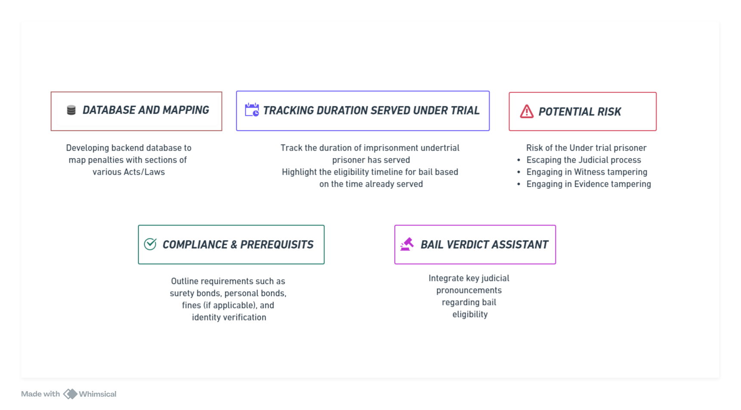
PROPOSED SOLUTION

Slide 5

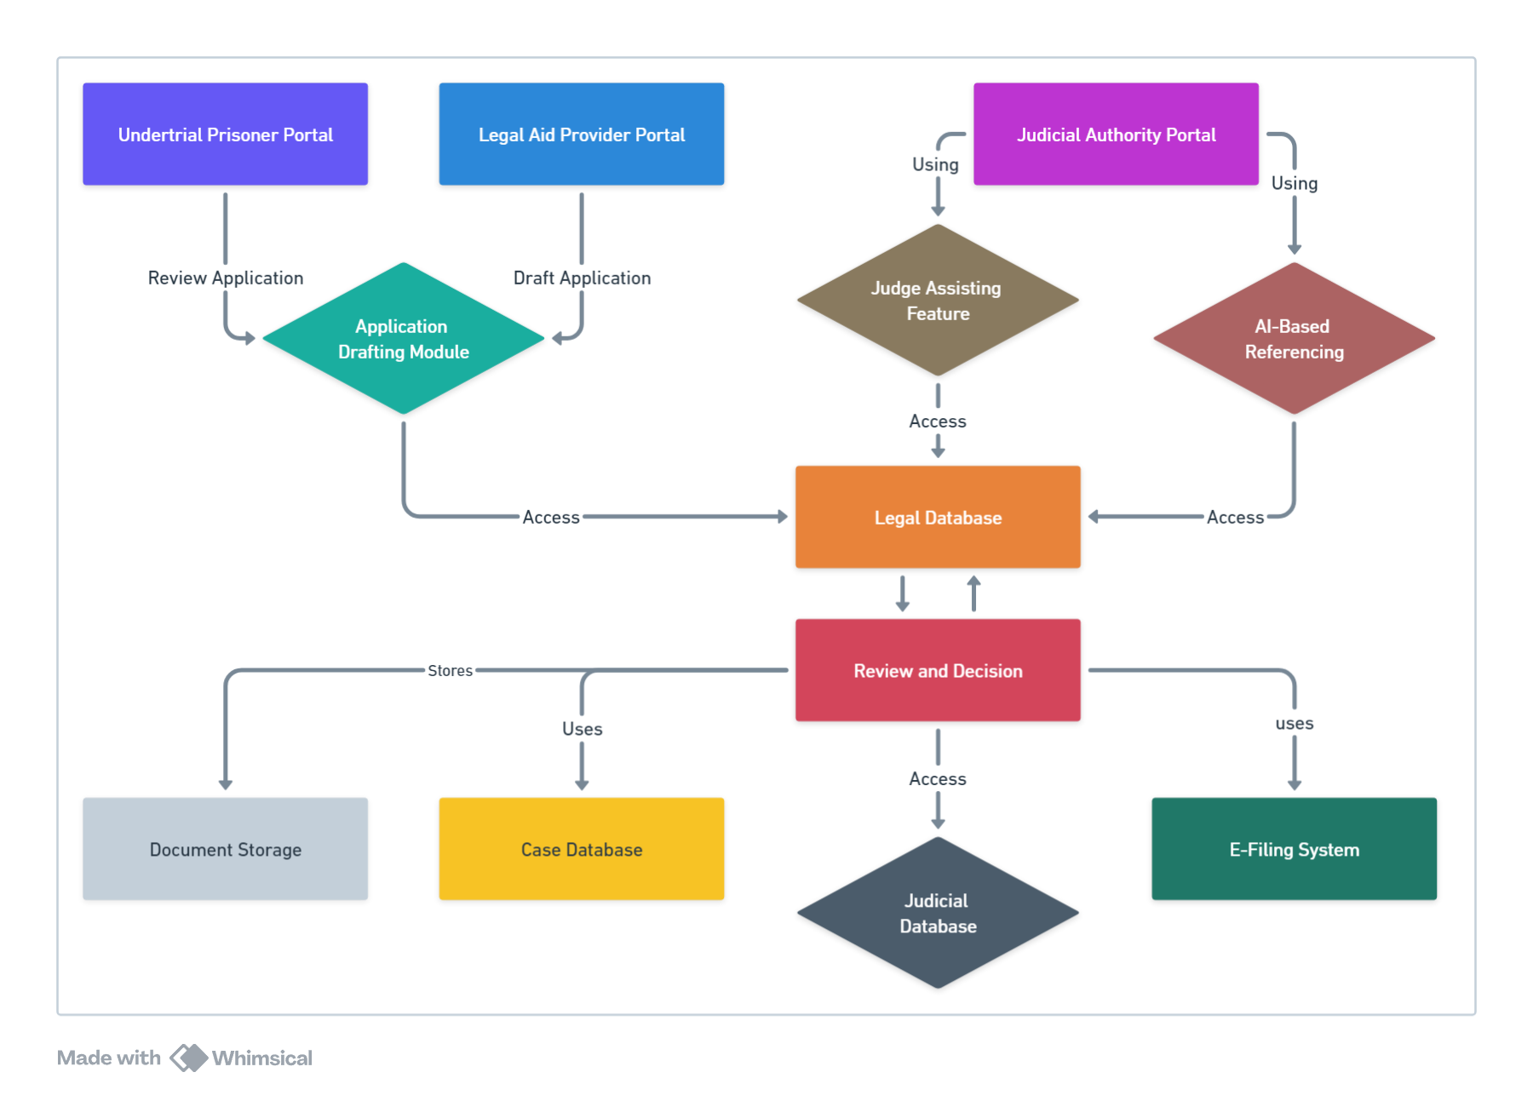
SYSTEM OVERVIEW

Slide 6

Why Bail Reckoner is comparitively effective ?
Tools like COMPASS do calculate the risk of recidivism
Using non legal factors like age , race , gender for risk assessment which make the results biased
Bail Reckoner’s comprehensive legal database ensures only all relevant legal aspects are considered eliminating the risk of biased results. .
Risk of biased decison :
1
Tools like CLIO and eCourts focus on legal practise management and case management
But does not provide evaluation of bail eligibility and risk asessment
Bail Reckoner’s has risk assessment,evaluation of bail eligibility,AI based referncing of previous similar cases as its main feature
Gap in Bail - Specific Tools:
2
The tool aids undertrial prisoners, in bail applications with user-friendly features like automated forms and easy navigation.
LexisNexis is designed for legal professionals, not tailored specifically to bail process
May not be user-friendly for undertrial prisoners.
3
User Accessibility and Interface:

Slide 7
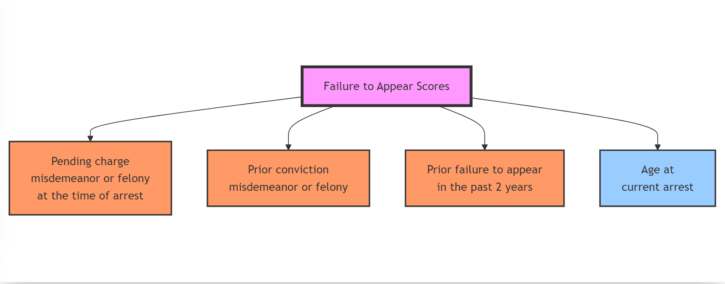
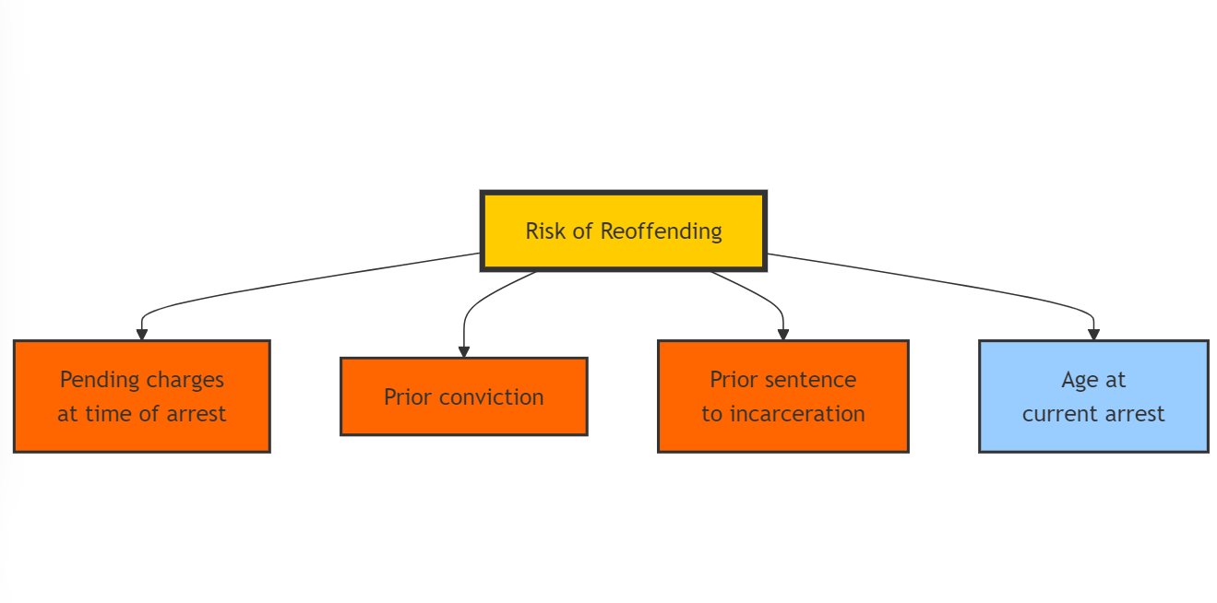
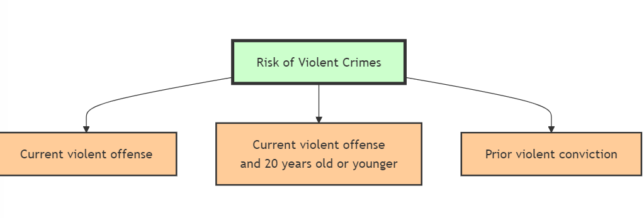

Slide 8

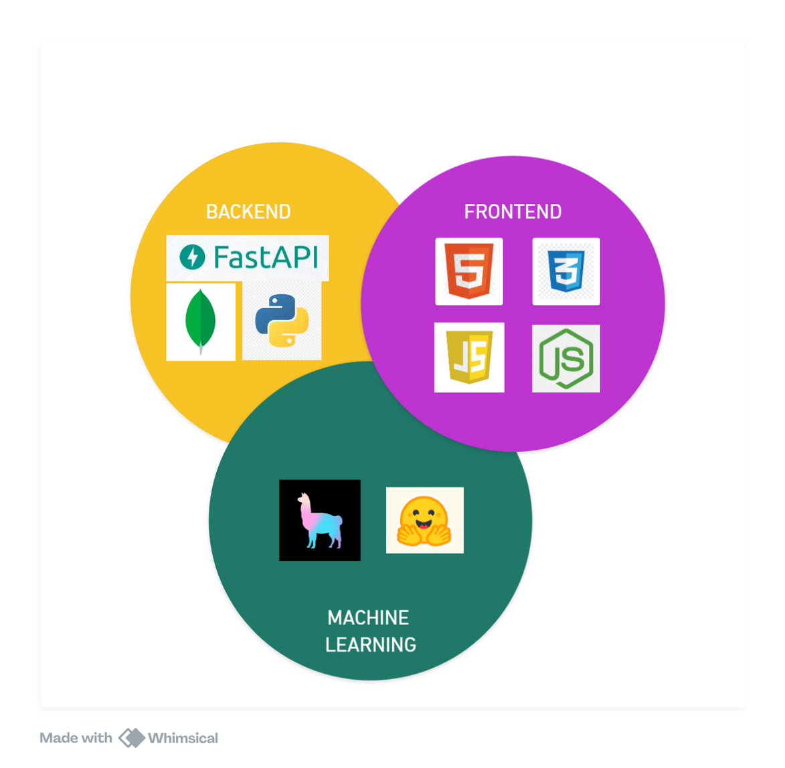
TECH STACK

Slide 9

THANK YOU

